Slide 1

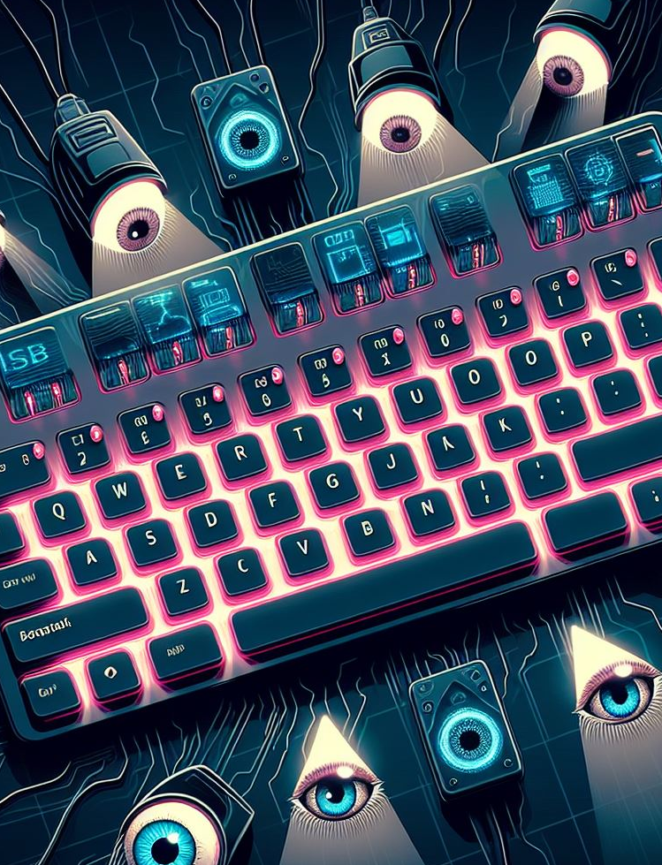
KEYLOGGER
Presented By: N MOHAMED HAFIZ AMAAN
College Name : Aalim Muhammed Salegh College of Engineering
Notes:
1

Slide 2

Outline
Introduction
Key Points
Implementation Strategy
A brief overview of the presentation structure and topics to be covered.
Highlighted key concepts and areas of focus in the cybersecurity landscape.
Approach to addressing cybersecurity threats and the proposed solutions.
Notes:
2

Slide 3

Problem Statement
In today's digital age, where cybersecurity threats loom large, one of the significant concerns is the proliferation of keylogger malware. This type of malware poses a severe threat to individuals, businesses, and organizations, as it clandestinely records keystrokes, potentially compromising sensitive information.
Notes:
3

Slide 4

Proposed Solution
1
Implementation of Multi-Factor Authentication
Integrate multi-factor authentication to add an extra layer of security for user verification.
2
Regular Security Audits
Conduct routine security audits to identify vulnerabilities and address them promptly.
3
User Awareness Programs
Empower users with knowledge on recognizing and mitigating cybersecurity threats through awareness programs.
Notes:
4

Slide 5

Challenges in Addressing Cybersecurity Threats
In the complex landscape of cybersecurity, the ever-evolving nature of threats presents significant challenges for organizations.
Addressing vulnerabilities amidst sophisticated attacks requires constant vigilance and proactive measures.
Notes:
5

Slide 6
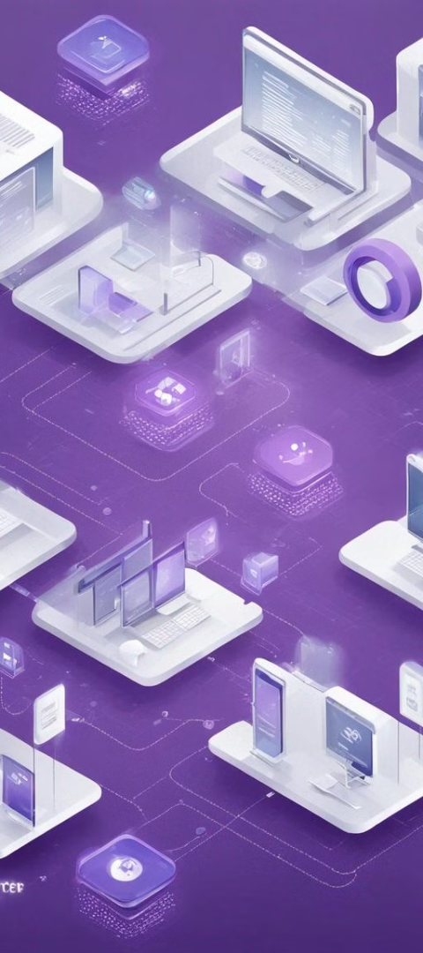



System Development Approach
Requirements Gathering
Collaborate with stakeholders to understand system needs and objectives.
System Design
Create a comprehensive plan, including architecture, interfaces, and data flow.
Development & Testing
Implement the design, ensuring functionality and security through rigorous testing.
Notes:
6

Slide 7

Algorithm and Deployment
The algorithm for cybersecurity must be robust and adaptive to evolving threats. Deployment efficiency is essential to ensure seamless integration without disrupting existing systems.
Notes:
7

Slide 8
Result
Analysis of Detected Threats
Incident Response and Mitigation
Evaluating the nature and impact of the detected security breaches.
Implementing strategies to address and mitigate the identified cybersecurity threats.
Adaptation of Security Protocols
Documentation and Reporting
Adjusting security protocols based on the outcomes of the threat analysis.
Documenting the results and preparing reports for stakeholders and future reference.
Notes:
8

Slide 9
File name: key_log.json
[{"Pressed": "'w'"}, {"Held": "'w'"}, {"Released": "'w'"}, {"Pressed": "'h'"}, {"Held": "'h'"}, {"Released": "'h'"}, {"Pressed": "'e'"}, {"Held": "'e'"}, {"Held": "'n'"}, {"Released": "'e'"}, {"Released": "'n'"}, {"Pressed": "Key.space"}, {"Held": "Key.space"}, {"Released": "Key.space"}, {"Pressed": "Key.shift"}, {"Held": "Key.shift"}, {"Held": "'F'"}, {"Released": "Key.shift"}, {"Released": "'f'"}, {"Pressed": "'i'"}, {"Held": "'i'"}, {"Released": "'i'"}, {"Pressed": "'n'"}, {"Held": "'n'"}, {"Released": "'n'"}, {"Pressed": "'a'"}, {"Held": "'a'"}, {"Held": "'l'"}, {"Released": "'a'"}, {"Released": "'l'"}, {"Pressed": "Key.space"}, {"Held": "Key.space"}, {"Released": "Key.space"}, {"Pressed": "Key.shift"}, {"Held": "Key.shift"}, {"Held": "'I'"}, {"Released": "'I'"}, {"Pressed": "'P'"}, {"Held": "'P'"}, {"Released": "'P'"}, {"Pressed": "'L'"}, {"Held": "'L'"}, {"Released": "Key.shift"}, {"Released": "'l'"}, {"Pressed": "Key.space"}, {"Held": "Key.space"}, {"Released": "Key.space"}, {"Pressed": "Key.right"}, {"Held": "Key.right"}, {"Released": "Key.right"}, {"Pressed": "Key.enter"}, {"Held": "Key.enter"}, {"Released": "Key.enter"}, {"Pressed": "Key.backspace"}, {"Held": "Key.backspace"}, {"Released": "Key.backspace"}, {"Pressed": "Key.backspace"}, {"Held": "Key.backspace"}, {"Released": "Key.backspace"}, {"Pressed": "Key.backspace"}, {"Held": "Key.backspace"}, {"Released": "Key.backspace"}, {"Pressed": "Key.backspace"}, {"Held": "Key.backspace"}, {"Released": "Key.backspace"}, {"Pressed": "Key.backspace"}, {"Held": "Key.backspace"}, {"Released": "Key.backspace"}, {"Pressed": "Key.backspace"}, {"Held": "Key.backspace"}, {"Released": "Key.backspace"}, {"Pressed": "Key.backspace"}, {"Held": "Key.backspace"}, {"Released": "Key.backspace"}, {"Pressed": "Key.backspace"}, {"Held": "Key.backspace"}, {"Released": "Key.backspace"}, {"Pressed": "Key.backspace"}, {"Held": "Key.backspace"}, {"Released": "Key.backspace"}, {"Pressed": "Key.backspace"}, {"Held": "Key.backspace"}, {"Released": "Key.backspace"}, {"Pressed": "Key.backspace"}, {"Held": "Key.backspace"}, {"Held": "Key.backspace"}, {"Held": "Key.backspace"}, {"Held": "Key.backspace"}, {"Held": "Key.backspace"}, {"Held": "Key.backspace"}, {"Held": "Key.backspace"}, {"Held": "Key.backspace"}, {"Held": "Key.backspace"}, {"Held": "Key.backspace"}, {"Held": "Key.backspace"}, {"Held": "Key.backspace"}, {"Held": "Key.backspace"}, {"Held": "Key.backspace"}, {"Held": "Key.backspace"}, {"Held": "Key.backspace"}, {"Held": "Key.backspace"}, {"Held": "Key.backspace"}, {"Held": "Key.backspace"}, {"Held": "Key.backspace"}, {"Held": "Key.backspace"}, {"Held": "Key.backspace"}, {"Held": "Key.backspace"}, {"Held": "Key.backspace"}, {"Released": "Key.backspace"}, {"Pressed": "'y'"}, {"Held": "'y'"}, {"Released": "'y'"}, {"Pressed": "'o'"}, {"Held": "'o'"}, {"Released": "'o'"}, {"Pressed": "'u'"}, {"Held": "'u'"}, {"Released": "'u'"}, {"Pressed": "'t'"}, {"Held": "'t'"}, {"Released": "'t'"}, {"Pressed": "'u'"}, {"Held": "'u'"}, {"Released": "'u'"}, {"Pressed": "'b'"}, {"Held": "'b'"}, {"Released": "'b'"}, {"Pressed": "'e'"}, {"Held": "'e'"}, {"Released": "'e'"}, {"Pressed": "Key.enter"}, {"Held": "Key.enter"}, {"Released": "Key.enter"}]
Notes:
9

Slide 10



Conclusion and future outlook
Enhanced Security Measures
1
Advanced encryption and multi-factor authentication
Cybersecurity Education
2
Continuous training to create a vigilant workforce
Collaborative Efforts
3
Industry partnerships for threat intelligence sharing
The future outlook entails implementing enhanced security measures such as advanced encryption and multi-factor authentication. Additionally, continuous cybersecurity education will be prioritized to create a vigilant workforce. Collaborative efforts through industry partnerships for threat intelligence sharing will also play a crucial role in addressing evolving cybersecurity challenges.
Notes:
10

Slide 11

Thank You
We appreciate your time and attention.
Thank you for considering our presentation.
Notes:
11

